Slide 1
TAM Model Effects of Social Media on Mental Health
Presented By:
Yamini Kuntal

Slide 2
Introduction
Interacting with social media platforms can influence mental health by shaping individuals' perceptions of information reliability and trustworthiness.
The availability of emotional connections and support on social media can impact mental well-being, either positively or negatively.
Social media engagement can expose individuals to potential risks and uncertainties, which can have implications for their mental health.
Perceived credibility of content and interactions on social media can shape individuals' self-perception and contribute to their mental well-being or distress.

Slide 3
Literature Review
In one study by (Khan et al., 2021) explores the drivers of social media usage among healthcare professionals using the technology acceptance model. The findings highlight the factors influencing perceived usefulness and actual adoption, providing insights for developing effective social media guidelines in healthcare.
Other study examines the relationship between social media usage and mental health during the COVID-19 outbreak in Wuhan (Zhong et al., 2021). Findings suggest that while social media provided support and information, excessive use was associated with mental health issues, emphasizing the importance of taking breaks to mitigate pandemic-related mental health harm.
Khan, M. I., Saleh, M. A., & Quazi, A. (2021). Social Media Adoption by Health Professionals: A TAM-Based Study. Informatics, 8(1), Article 1. https://doi.org/10.3390/informatics8010006
Zhong, B., Huang, Y., & Liu, Q. (2021). Mental health toll from the coronavirus: Social media usage reveals Wuhan residents’ depression and secondary trauma in the COVID-19 outbreak. Computers in Human Behavior, 114, 106524. https://doi.org/10.1016/j.chb.2020.106524

Slide 4
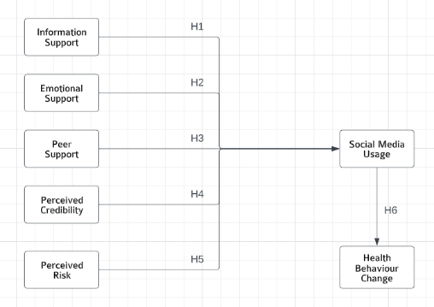
Theoretical Framework
Fig:1 Research model on effects of social media on mental health

Slide 5
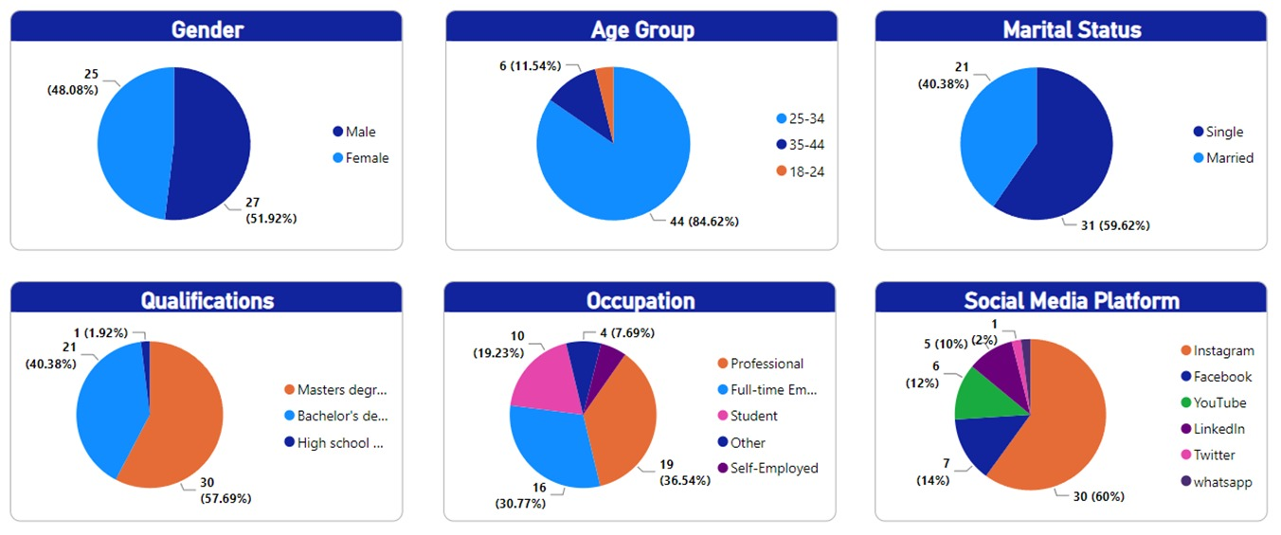
Data Collection

Slide 6
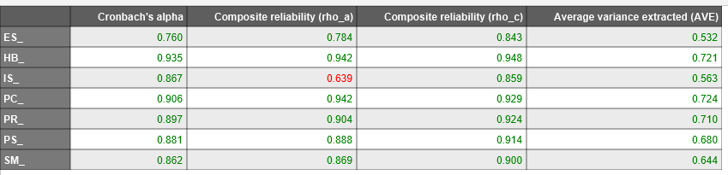
Results (Reliability)
Items reliably measure the construct as Cronbach's alpha > 0.7 (threshold)
Items do adequately reflect the construct's common variance as AVE > 0.5 (threshold)

Slide 7
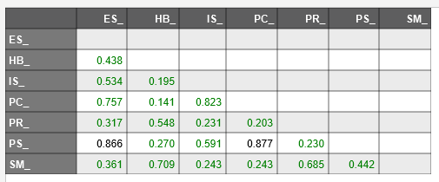
Results (Discriminant Validity)
Discriminant validity has been determined between a given pair of reflective constructs using HTMT criterion as the values are below 0.90 threshold

Slide 8
Results Hypothesis Testing
Hypothesis Testing | Original sample (O) | Sample mean (M) | Standard deviation (STDEV) | T statistics (¡O/STDEVI) | P values
Emotional Support -> Social Media Usage | -0.044 | 0.002 | 0.192 | 0.229 | 0.819
Information Support -> Social Media Usage | 0.111 | 0.066 | 0.16 | 0.695 | 0.487
Perceived Credibility -> Social Media Usage | -0.389 | -0.272 | 0.235 | 1.66 | 0.097
Perceived Risk -> Social Media Usage | 0.552 | 0.559 | 0.135 | 4.087 | 0
Peer Support -> Social Media Usage | 0.559 | 0.47 | 0.218 | 2.559 | 0.011
Social Media Usage -> Health Behaviour Change | 0.648 | 0.663 | 0.074 | 8.721 | 0
Perceived Risk and Peer Support are significant to social media usage
Social Media Usage is also significant to Health Behavior Change

Slide 9
Conclusion
Perceived risk and peer support significantly influence individuals' usage of social media in the context of mental health.
Provides valuable insights for healthcare providers, policymakers, and individuals seeking to navigate the complex relationship between social media and mental well-being.

Slide 10
THANK YOU

